Slide 1
Breast Cancer Detection

Slide 2
Table of Contents
01
02
03
Introduction
Problem Defination
Dataset
04
05
Methods
Result & conclusion

Slide 3
Introduction
Statistics of breast cancer cases
In the world

Slide 4
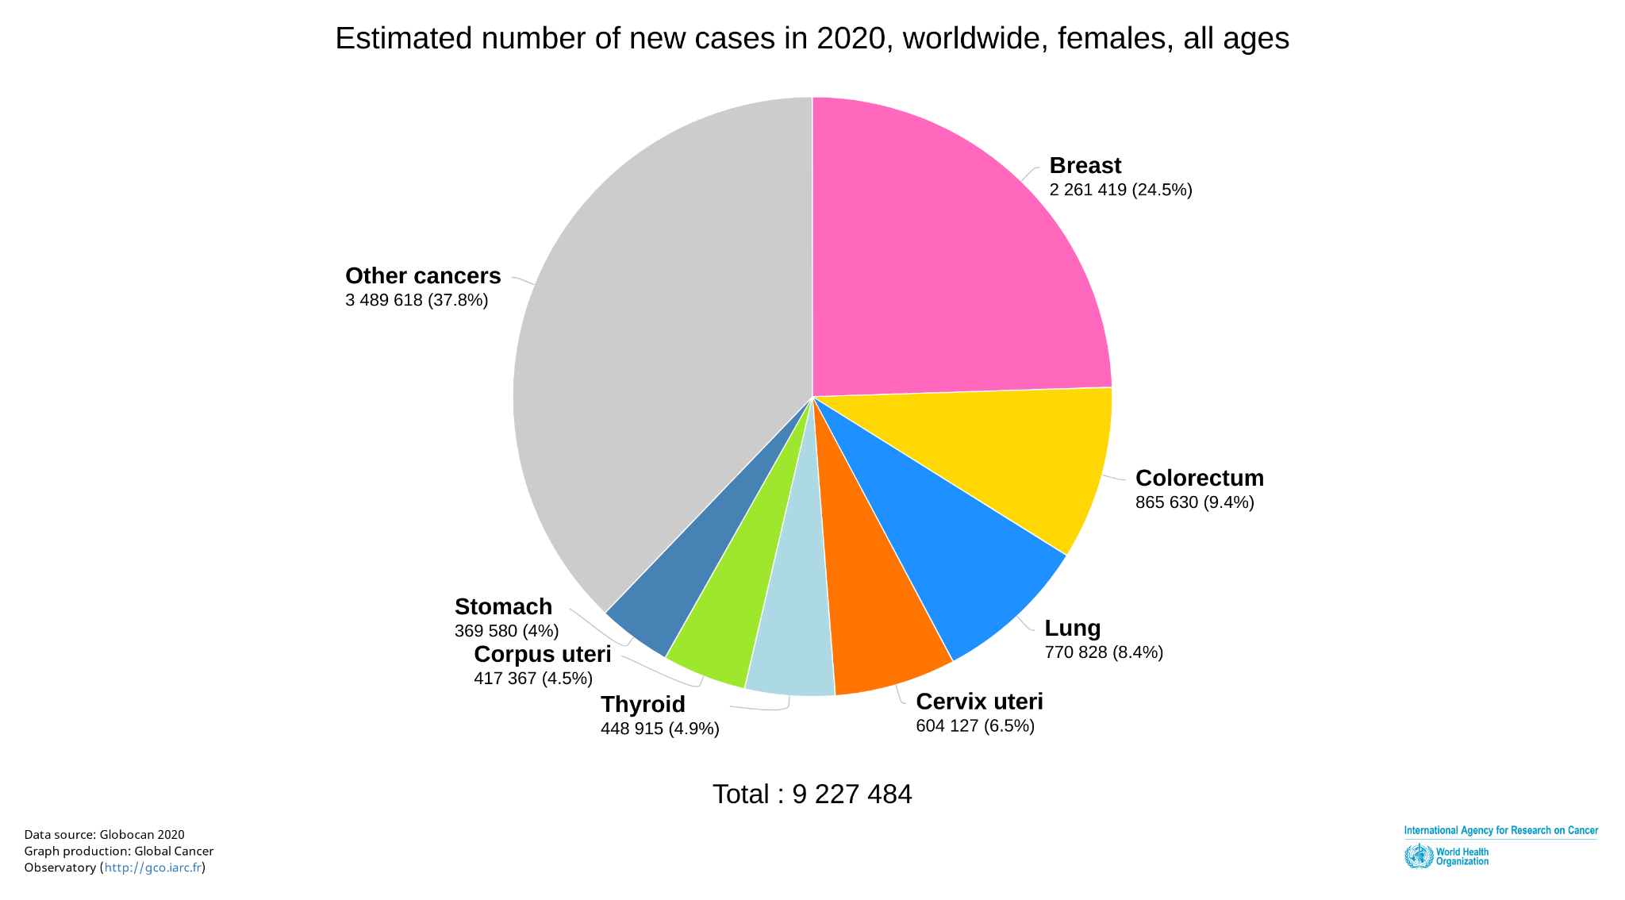
01
Statistics of the breast cancer in the world

Slide 5
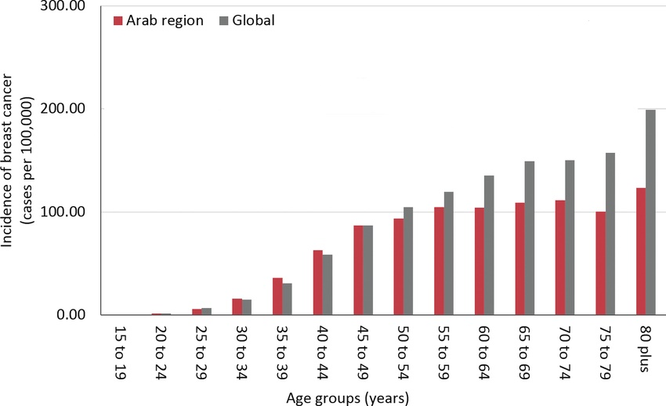
02
Statistics of the breast cancer in the world vs arab region

Slide 6
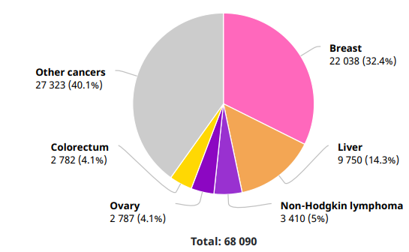
03
Statistics of the breast cancer in the Egypt

Slide 7
Problem Defination

Slide 8
Different Algorithm
Compare between different algorithm to get highest accuracy model:
Naive bayes
SVM
K-Nearest Neighbor
Logistic regression

Slide 9
API
Make a Website that take:
Data of patient and predict either the patient have a cancer or not

Slide 10
Dataset

Slide 11
Breast Cancer Wisconsin (Diagnostic) Dataset
Features are computed from a digitized image of a fine needle aspirate (FNA) of a breast mass. They describe characteristics of the cell nuclei present in the image.

Slide 12
Features for cell nucleus
radius
smoothness
mean of distances from center to points on the perimeter
local variation in radius lengths
texture
standard deviation of gray-scale values
compactness
perimeter^2 / area - 1.0
perimeter
area
concavity
severity of concave portions of the contour

Slide 13
Features for cell nucleus
concave points
ID number
number of concave portions of the contour
symmetry
standard deviation of gray-scale values
Diagnosis
M = malignant, B = benign
fractal dimension
"coastline approximation" - 1

Slide 14
preparations & preprocessing

Slide 15
Read Dataset
Explore the dataset
Replace the M with 1 and B with 0
Heatmap
Clean the unneeded features
Split the data into train and test

Slide 16
Methods

Slide 17
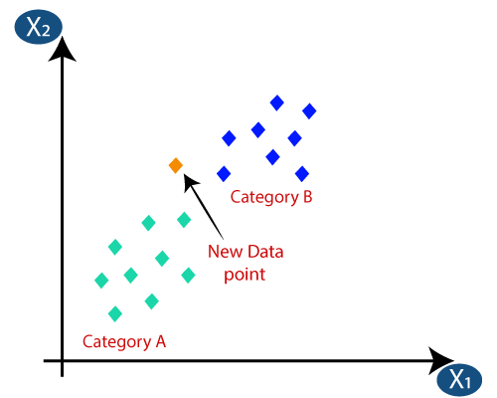
KNN

Slide 18
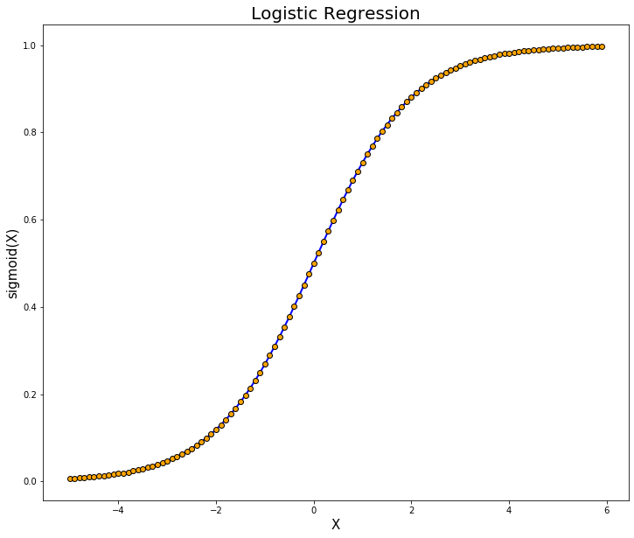

Logistic Regression

Slide 19
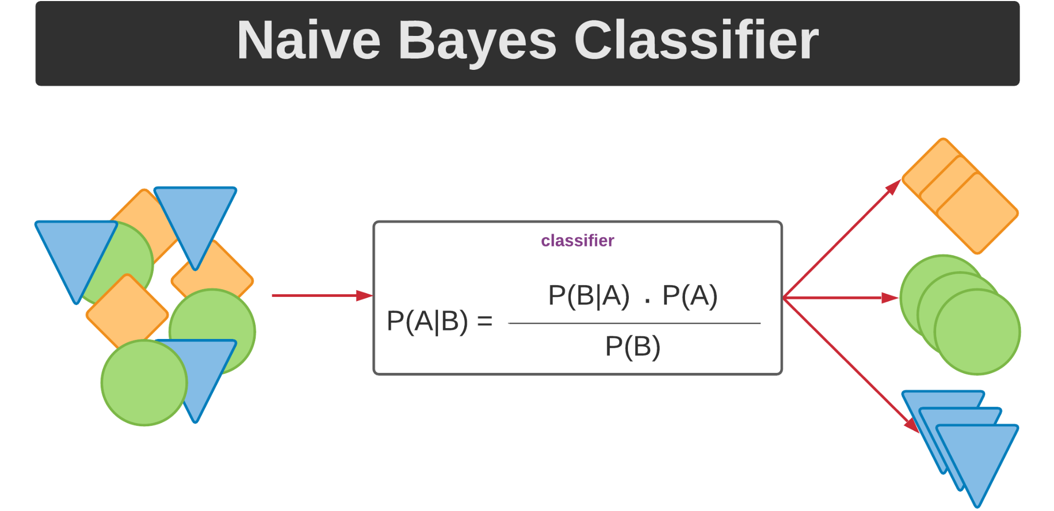
Naive Bayes

Slide 20

SVM

Slide 21
Results & Conclusion

Slide 22
Result Comparison
Model | Logistic Regression | Naive Bayes | K-Nearest Neighbour | Support Vector Machine
Accuracy | 97.076023 | 90.058480 | 93.567251 | 97.660819

Slide 23
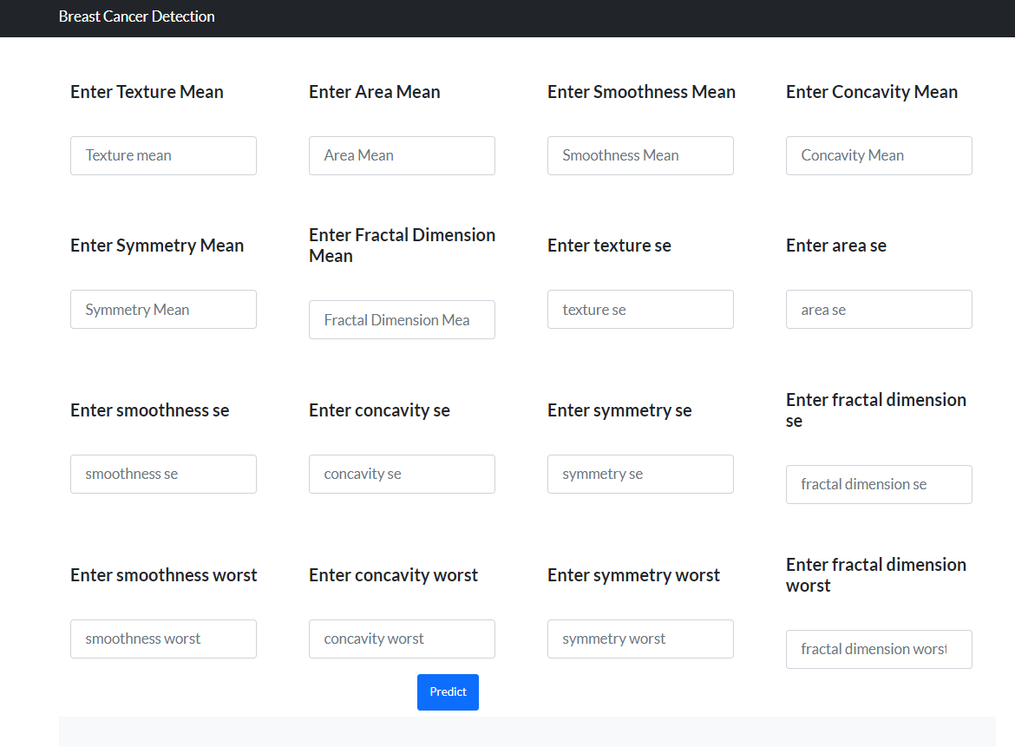
Web API

Slide 24
Conclusions
support vector machine achieves best results among all used classifiers.

Slide 25
Future work
Design CNN Model that take images instead of numbers to predict Tumor nature.

